Slide 1
Functional Programming in R
Using the purrr package

Slide 2
About me
Tom Jemmett
Senior Healthcare Analyst @ Strategy Unit
Previously Information Analyst in NHS Trusts
BSc in Computer Science and Pure Mathematics

Slide 3
Session Outline
What are functions, and how to create your own in R
What is functional programming?
Higher order functions
Resources used:
Chapter 19 (Functions) of “R for Data Science”
Chapters 9-11 (Functional Programming Section) of “Advanced R”

Slide 4
What are functions?
Functions go by different names in different programming languages: sometimes you will see them referred to as subroutines, procedures or methods.
Functions contain sequences of code to perform specific tasks.
Functions can take different “arguments” and may return a value.
In R, functions can be assigned like any other variable using the “<-” operator, and are created using the “function” keywork.
After the “function” keyword, there are a set of parentheses “( )” which can contain zero or more variables.
Functions in R will return the last value that was executed.
Functions can use variables defined in the parent environment, but variables declared within the function can only be accessed within the function.

Slide 5
Exercise 1: Your first function
Create a function called “my_function” that takes a single value “x”, multiplies x by 3 and then adds 1
Remember, R will “return” the last executed line of code from a function. This value doesn’t need to be assigned to another value before returning it.
Once you have created your function, try executing it with my_function(3): you should get the value 10.
What happens when you execute your function with different types of values, like logicals (TRUE/FALSE), doubles (2.4, pi), or strings? What about NULL or NA?
What happens when you try to execute your function with more than one variable? my_function(3, 1)
my_function <- function(x) {
your_code_here
}

Slide 6
When should we create our own functions?
Consider the following code from R4DS, what issues can you identify?
df <- tibble::tibble(
a = rnorm(10),
b = rnorm(10),
c = rnorm(10),
d = rnorm(10)
)
df$a <- (df$a - min(df$a, na.rm = TRUE)) /
(max(df$a, na.rm = TRUE) - min(df$a, na.rm = TRUE))
df$b <- (df$b - min(df$b, na.rm = TRUE)) /
(max(df$b, na.rm = TRUE) - min(df$a, na.rm = TRUE))
df$c <- (df$c - min(df$c, na.rm = TRUE)) /
(max(df$c, na.rm = TRUE) - min(df$c, na.rm = TRUE))
df$d <- (df$d - min(df$d, na.rm = TRUE)) /
(max(df$d, na.rm = TRUE) - min(df$d, na.rm = TRUE))
Notes:
Code has been taken from 19.2 of R4DS (https://r4ds.had.co.nz/functions.html), H.Wickham & G.Grolemund, CC BY-NC-ND 3.0 US

Slide 7
When should we create our own functions?
The same code is repeated over and over
A bug has been introduced on the df$b assignment: it uses the minimum value from df$a, not df$b
This is a perfect candidate to become a separate function!
df$a <- (df$a - min(df$a, na.rm = TRUE)) /
(max(df$a, na.rm = TRUE) - min(df$a, na.rm = TRUE))
df$b <- (df$b - min(df$b, na.rm = TRUE)) /
(max(df$b, na.rm = TRUE) - min(df$a, na.rm = TRUE))
df$c <- (df$c - min(df$c, na.rm = TRUE)) /
(max(df$c, na.rm = TRUE) - min(df$c, na.rm = TRUE))
df$d <- (df$d - min(df$d, na.rm = TRUE)) /
(max(df$d, na.rm = TRUE) - min(df$d, na.rm = TRUE))

Slide 8
Exercise 2: Fix the R4DS bug
Create a function called “rescale” that implements the code from R4DS, then rewrite the variable reassignment using your new function
df$a <- (df$a - min(df$a, na.rm = TRUE)) /
(max(df$a, na.rm = TRUE) - min(df$a, na.rm = TRUE))

Slide 9
Exercise 3: Create a function to generate a plot
Using the “ae_attendances” dataset from the “NHSRDatasets” package, create a function that takes two arguments, one called data (which will always be a subset of the ae_attendances dataset) and an argument called title.
After the title argument, give it a default value, like title = “A&E Attendances”
We want to create a plot of the number of attendances over time, so within the function you will need to run something similar to the following:
df <- data %>%
group_by(period) %>%
summarise_at(vars(attendances), sum)

Slide 10
Summary of functions in R, plus a few other bits
Functions are created using the “function” keyword and are assigned like any other variable
Functions can take zero or more arguments, and return the last executed value
Functions should do some kind of checks to make sure the values passed to the function make sense
Because functions are just variables, you can inspect the function by just typing in the name of the function into the console (without the brackets) and pressing enter
All operators in R are actually functions, including “+”, “<-” and “[“, which can be overloaded (for example, ggplot uses “+” to add parts of plots together)
Functions can be made “infix” if they start and finish with a “%” (e.g. %>%)
Suggested reading: Chapter 19 of R4DS.
Notes:
See the comments associated with each bullet point above for further details

Slide 11
What is functional Programming?
A programming paradigm (style) that treats computation as the evaluation of mathematical functions
It is a declarative style of programming where the code describes what you are trying to achieve, rather than how to achieve it
SQL is an example of a declarative programming language – you are saying what you want as your end goal, but you don’t explicitly state do this, then this…
True Functional Programming languages avoid mutable data and side effects
No variables, only constants!!!
Can only use data passed as an argument
Cannot change data outside of the function

Slide 12
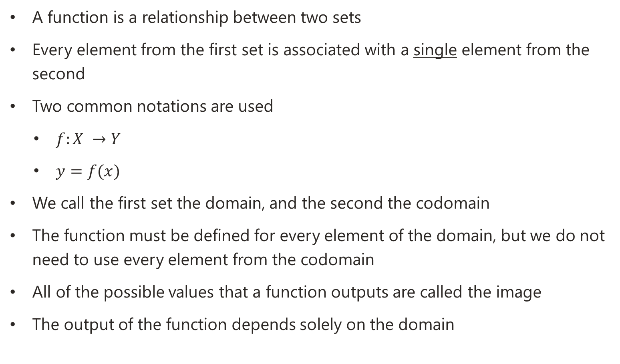
What is a mathematical function?
A function is a relationship between two sets
Every element from the first set is associated with a single element from the second
Two common notations are used
$f:X →Y$
$y=f(x)$
We call the first set the domain, and the second the codomain
The function must be defined for every element of the domain, but we do not need to use every element from the codomain
All of the possible values that a function outputs are called the image
The output of the function depends solely on the domain
Notes:
Mathematical functions have a much stricter definition than what a function allows in R. However, it’s worth noting that mathematics is not just about numbers, in fact the set’s noted above (the domain and codomain) could be anything, whole numbers (integers), fractions, irrational numbers, or shapes, colours, animals… pretty much anything!

Slide 13
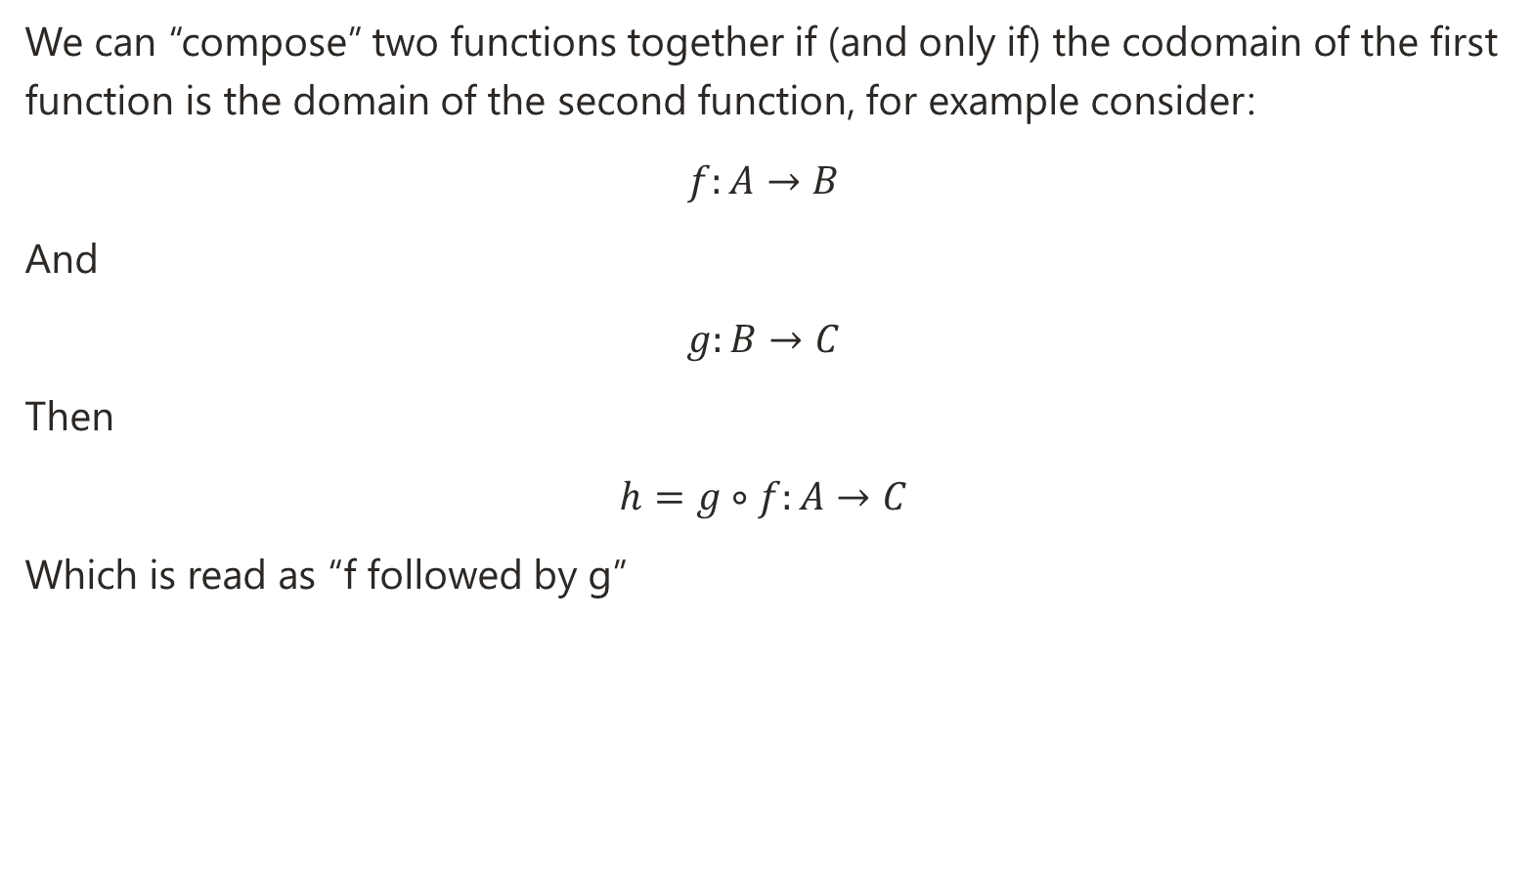
Mathematical functions continued
We can “compose” two functions together if (and only if) the codomain of the first function is the domain of the second function, for example consider:
$$f:A→B$$
And
$$g:B→C$$
Then
$$h=g∘f:A→C$$
Which is read as “f followed by g”

Slide 14
Are R functions mathematical functions?
Maybe?
You can force your self to write functions that match the strict rules as outlined in the previous slide, namely:
The arguments of the function are the domain
The return value of the function is the codomain/image
A function’s definition relies solely on the domain an the codomain
Every value of the domain has a valid value in the codomain
The benefits of sticking to these rules are:
They will always return the same values given the same inputs
They are easy to test
We can compose simple functions to achieve complexity
Notes:
Maybe: it depends entirely on your own function implementation and whether you want to follow the strict rules laid out.

Slide 15
Introduction to purrr::map
So far we have focused on functions that take a single value for each argument and return one value. But what if we have a list of values?
We could write a loop to iterate over every element in our list, evaluate our function for each element, and assign to a new variable…
But this is boilerplate code! Code we have to write all of the time! (It also doesn’t play well in dplyr pipelines)
The map function from the purrr package takes a vector/list of values as input and a function to execute, runs the function once for each value, and returns a list with the results

Slide 16
map syntax
The map function has a pretty simple syntax
map(.x, .f, …)
The Arguments are
.x The list/vector you are mapping over
.f can be a function, formula of vector
If a function, used as is
Formula’s start with a “~”, then the code follows. The values are stored in the variable “.x”, for example ~ 3*.x + 1
Vectors are used to access elements by index
… are additional arguments that are passed into .f
map(.x, .f, …) => .f(.x[[1]], …), .f(.x[[2]], …), .f(.x[[3]], …), …

Slide 17
Variants of the map function
Function | Function Returns | Map Results
map | Any data type | List
map_chr | Characters (strings) | Vector of Characters
map_dbl | Numeric | Vector of Numeric’s
map_lgl | Logical (True/False) | Vector of Logical’s
map_int | Integer | Vector of Integers
map_raw | Raw (byte) | Vector of Raw’s (bytes)
map_dfr / map_df | Dataframe | A single Dataframe, combined row-wise
map_dfc | Dataframe | A single Dataframe, combined column-wise
The values for the vector functions must returns lists the same length as the input, but map/map_dfr can return different sized values for each result. map_dfc must return tables of the same number of rows
Notes:
Most common/useful variants are highlighted. map_int can be problematic as it expects the values to be integers. It’s often easier to use map_dbl and get a numeric.
map_raw is pretty special case for if you are dealing with raw bytes of data.
In my experience map_dfr is far more commonly used than map_dfc, as you tend to return tables of data. However, if you have a function that returns something like (id, col_a), (id, col_b), (id, col_c) then map_dfr would create (id, col_a, col_b, col_c) whereas map_dfc would create (id, col_a, col_b, col_c)

Slide 18
Exercise 4: Introduction to map
Evaluate “my_function” with the values 1 through 10 by using map
(You can use 1:10 to get the numbers 1 to 10, or seq(1, 10, 1), or c(1,2,3,4…))
map returns a list of values, which may not be the most useful type. Try changing your code to use map_dbl instead to get a vector of doubles
Try my_function(1:10), what are the results? Do they match what you got with map_dbl?
my_function is pretty simple – only one line of code. Try replacing my_function in the map calls with ~ 3*.x + 1, do you get the same results?

Slide 19
Exercise 5: Map over all columns in a dataframe
In exercise 2 you created a function called rescale, but then had to call this function once for each column. In exercise 4 you met map and map_dbl, but saw that you could just pass in the vector of values to the function without map and get the same results.
Try using map_dfr (dfr: data frame, combine by rows) with df and rescale.
Then try rescale(df). Do you get the same results now?

Slide 21




Stay connected with us!
https://www.strategyunitwm.nhs.uk/
@Strategy_Unit
0121 612 1538
strategy.unit@nhs.net

